Slide 1
Roles in Families Affected by Chemical Dependence
Father with Chemical Dependence
Enabler (spouse/partner)
Hero
Scapegoat
Lost Child
Mascot

Slide 2
Parent with CD

Slide 3
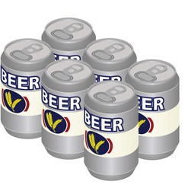
Parent with CD
“11 feet tall, invincible, and bullet-proof”
Len McDonald, Recovery Partnership

Slide 4
Parent with CD

Slide 5
Parent with CD

Slide 6
Parent with CD
Enabler/Spouse

Slide 7
Parent with CD
Enabler/Spouse

Slide 8
Parent with CD
Enabler/Spouse

Slide 9
Hero

Slide 10
Parent with CD
Enabler/Spouse
Hero

Slide 11
Scapegoat

Slide 12
Parent with CD
Enabler/Spouse
Scapegoat
Hero

Slide 13
Lost Child

Slide 14
Parent with CD
Lost Child
Enabler/Spouse
Scapegoat
Hero

Slide 15
Mascot

Slide 16
Parent with CD
Lost Child
Mascot
Enabler/Spouse
Scapegoat
Hero

Slide 17
Scapegoat

Slide 18
